Slide 1





Real-Time Machine Learning-Based Drowsiness Detection
Team :
Arathi S arathisriram.28@gmail.com Hamsa D M dt96329747812gmail.com
Madhushree C K madhushree2292003@gmail.com
Priyanka B R pruthvibr385@gmail.com
Guide: Adharsh, Trainer at Edunet Foundation
Disclaimer: The content is curated for educational purposes only.
Notes:
Slides: Prepare a short slide deck (10-12 slides) summarizing the project objectives, methodology, and key results.

Slide 2
OUTLINE
Abstract of the Project
Problem Statement
Proposed Solution
System Architecture
Live Demo of the Project
Embedded Video of Project
Conclusion
Future Scope

Slide 3
Abstract
Many of the accidents occur due to drowsiness of drivers. It is one of the critical causes of roadways accidents now-a-days.
Latest statistics say that many of the accidents were caused because of drowsiness of drivers. Vehicle accidents due to drowsiness in drivers are causing death to thousands of lives. More than 30% accidents occur due to drowsiness. For the prevention of this, a system is required which detects the drowsiness and alerts the driver which saves the life.
In this project, we present a scheme for driver drowsiness detection. In this, the driver is continuously monitored through webcam. This model uses image processing techniques which mainly focus on face and eyes of the driver.
The model extracts the drivers face and predicts the blinking of eye from eye region. We use an algorithm to track and analyze drivers face and eyes to measure Haar Cascade. If the blinking rate is high then the system alerts the driver with a sound.

Slide 4
Problem Statement
Many of the road accidents will occur due to drowsiness of the driver. Drowsiness can be detected by monitoring the driver through continuous video stream with a mobile or camera. The general objective is to create a model that will indicate whether a person is feeling drowsy or not. The model takes image for every second and check for eye blinking and calculates the time for eye closed by Haar Cascade algorithm. If the blinking is high and eye is closed for certain amount of time then it will indicate driver through a sound.

Slide 5
Proposed Solution
Image Acquisition (Face & Eye Detection)
A camera (webcam, mobile camera, or in-car IR camera) continuously captures images of the driver.
The eye region is extracted from the detected face for further analysis.
2. Eye Blink & Drowsiness Detection (Haar Cascade Algorithm)
If the eye closure duration exceeds a predefined threshold (e.g., 80% closed for 1–2 seconds), drowsiness is detected.
3. Alert Mechanism
When drowsiness is detected, an immediate alert is triggered
Audio Alert: A loud buzzer or alarm to wake the driver.

Slide 6
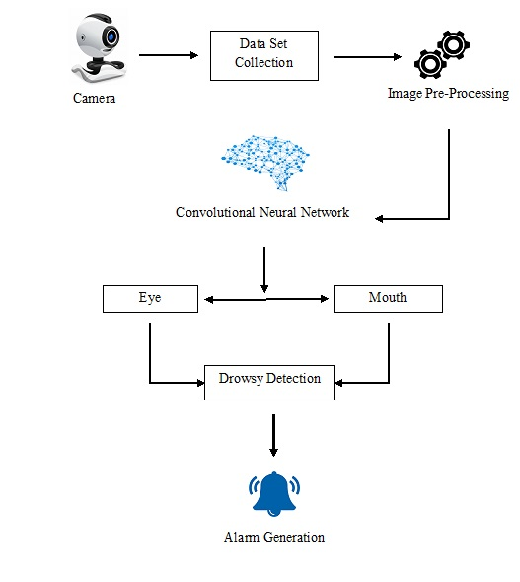
System Architecture
Haar Cascade Algorithm
Eye
Head Movement

Slide 7
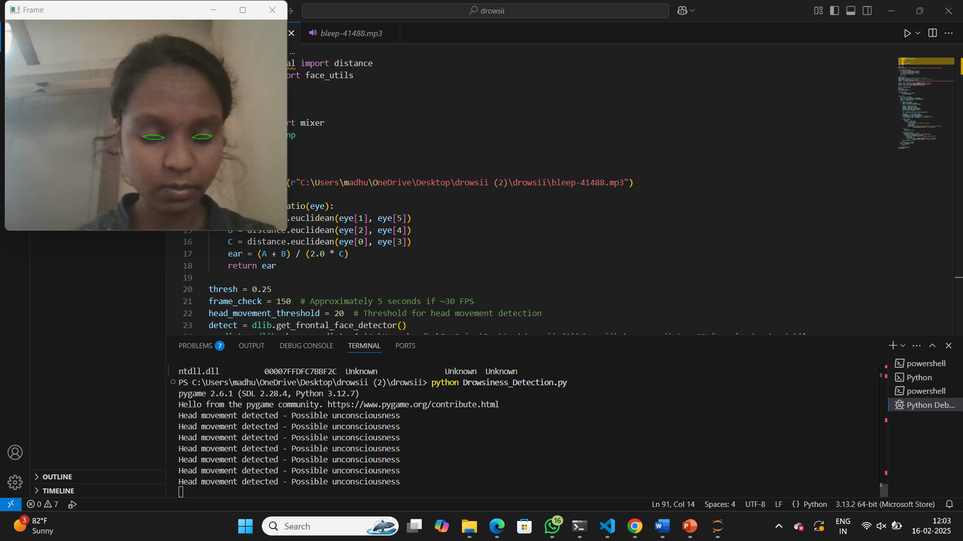
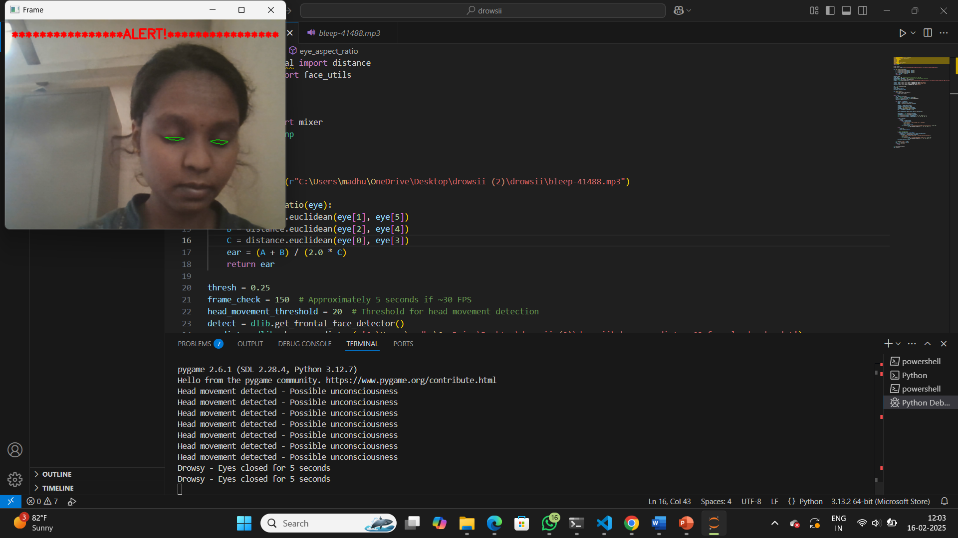
Live Demo of Project
Detected Drowsy Make some alarm like alert Message

Slide 8

Video of Project Demo

Slide 9
Conclusion
Real-time drowsiness detection systems using facial features show promise in identifying driver fatigue based on studies, but require further investigation in real-world scenarios. Continued development of these systems has the potential to improve road safety by preventing accidents caused by drowsy driving. Future research should focus on combining detection methods for better accuracy and integrating this technology into cars and autonomous vehicles.

Slide 10
Future Scope
Integration with Vehicle Control Systems: Connect the model with the vehicle’s control system to slow down or stop the vehicle when drowsiness is detected.
Multimodal Drowsiness Detection: Combine eye-tracking with head position, yawning detection, and facial expression analysis for more accurate results.
Mobile and IoT-based Implementation: Develop a mobile app that works with a smartphone camera to monitor driver drowsiness.

Slide 11
Thank you!
Notes:
thank you very much for joining this PPT, keep learning.
11

